Slide 1
IN 3230 / IN 4230 Oracle Session – Week 3 – ARP Protocol
Praveensankar Manimaran
16/09/2021

Slide 2
Outline
ARP Protocol
ARP Request
ARP Response
Different Components needed
Packet socket
sockaddr_ll
Ifaddrs
iovec
ether_frame
msghdr

Slide 3
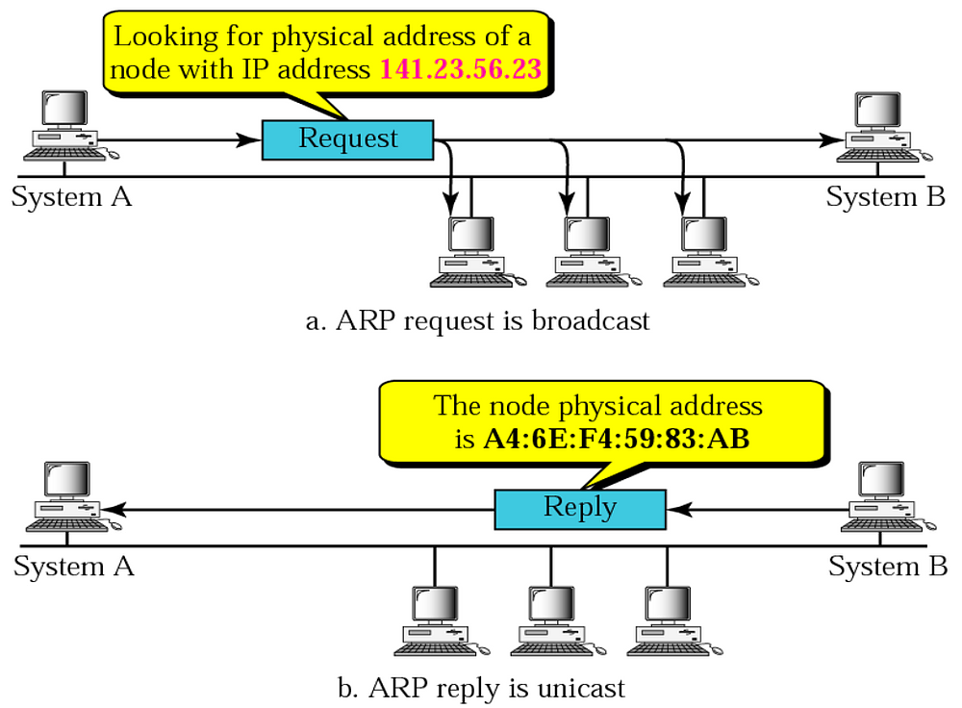
1 . ARP Protocol
ARP – Address Resolution Protocol
Maps ip address to
physical address (mac address)
Used by the switches or o
ther layer 2 devices
[1] ARP Protocol image reference : link
Fig: ARP Protocol [1]

Slide 4
ARP Request
Steps:
Construct frame header (source address, dest address (broadcast address), protocol)
Point msg vec to frame header ( msg vec and msg vec len)
Construct msg header
Point the msg name to the source sock address (sockaddr ll)
Point the msg iovec to the msg vec
Send msg

Slide 5
ARP Response
Steps:
Construct frame header (source address, dest address (unicast address), protocol)
Point msg vec to frame header ( msg vec and msg vec len)
Construct msg header
Point the msg name to the source sock address (sockaddr ll)
Point the msg iovec to the msg vec
Send msg
The node which receives the ARP response can find out the other nodes mac address by checking the source address in frame header

Slide 6
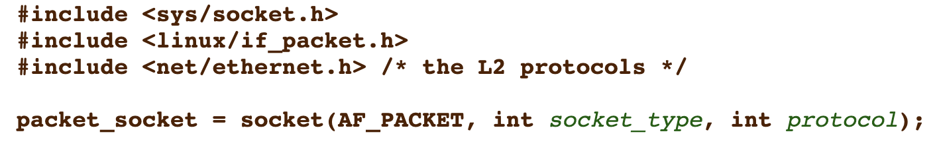
2 . 1 Packet Socket (AF_PACKET)
a
AF_PACKET:
Also called as "packet socket".
used to receive or send raw packets at the device driver
SOCK_RAW:
for raw packets
3. 0xFFFF:
For broadcast (but other protocols also can be used other popular option is using ETH_P_ALL)
[1] https://man7.org/linux/man-pages/man7/packet.7.html

Slide 7
2 . 2 Sockaddr_ll
a
struct sockaddr_ll {
unsigned short sll_family; /* Always AF_PACKET */
unsigned short sll_protocol; /* Physical-layer protocol */
int sll_ifindex; /* Interface number */
unsigned short sll_hatype; /* ARP hardware type */
unsigned char sll_pkttype; /* Packet type */
unsigned char sll_halen; /* Length of address */
unsigned char sll_addr[8]; /* Physical-layer address */
};
[1] https://man7.org/linux/man-pages/man7/packet.7.html
[2] https://github.com/spotify/linux/blob/master/include/linux/if_ether.h

Slide 8
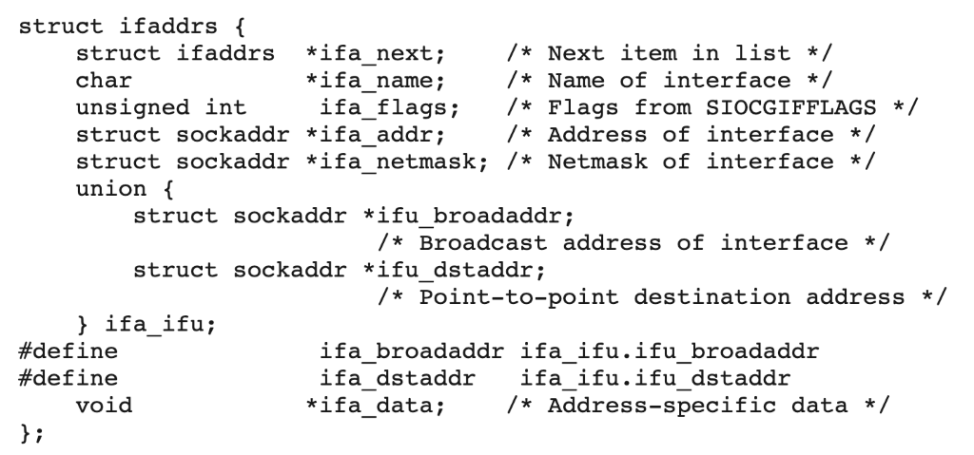
2 . 3 ifaddrs
a
creates a linked list of structures describing the network interfaces of the local system, and stores the address of the first item of the list in *ifap.
Important fields: ifa_next, ifa_name and ifa_addr
[2] https://man7.org/linux/man-pages/man3/getifaddrs.3.html

Slide 9
2 . 4 iovec
a
struct iovec { ptr_t iov_base; /* Starting address */ size_t iov_len; /* Length in bytes */ };
iov_base – stores the starting address
Iov_len – stores the length
Why it's needed ?
It's used by the message header (msghdr)
To point to ethernet frame header and the payload

Slide 10
2 . 5 ether_frame
a
struct ether_frame {
uint8_t dst_addr[6];
uint8_t src_addr[6];
uint8_t eth_proto[2];
uint8_t contents[0]; } __attribute__((packed));
It's frame header we use in the raw socket ( it contains the mac address needed in the ARP request and response)
__attribute__ ((packed)): it packs the ether_frame in such a way that it preserves memory (removes automatic padding between the structure members)

Slide 11
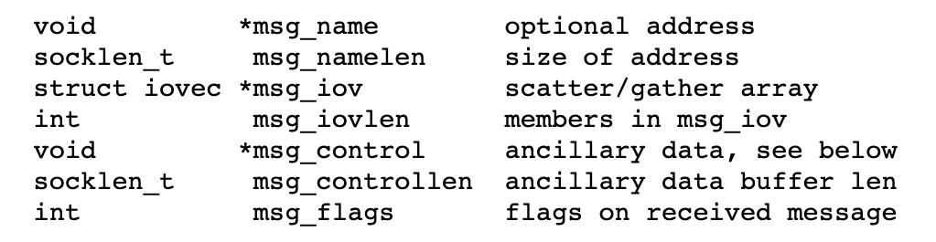
2 . 6 msghdr
a
Msg_name : sockaddr pointer will be used here (struct sockaddr_ll *)
Msg_namelen: size of sockaddr pointer
Msg_iov: array of io vector structures ( we use 1 arrays. It points to the frame header)
Msg_iovlen: no of numbers in msg_iov ( 1 in our example)

Slide 12
References
https://man7.org/linux/man-pages/man7/packet.7.html
https://man7.org/linux/man-pages/man3/getifaddrs.3.html
http://www.ccplusplus.com/2012/02/struct-iovec-iov.html
msghdr : https://pubs.opengroup.org/onlinepubs/7908799/xns/syssocket.h.html

Slide 13
Thank You

